Slide 1

Key Indicators of Heart Disease 2020 annual CDC survey data of 400k adults related to their health status.
Presented by: Dana Mahmoud Mohamed

Slide 2
About dataset:
The Personal Key Indicators of Heart Disease dataset contains 320K rows and 18 columns. It is version of the 2020 annual CDC (Centers for Disease Control and Prevention) survey data of 400k adults. For each patient (row), it contains the health status of that individual. The data was collected in the form of surveys conducted over the phone. Each year, the CDC calls around 400K U.S residents and asks them about their health status, with the vast majority of questions being yes or no questions. The dataset contains 18 variables (9 Booleans, 5 strings and 4 decimals). In machine learning projects, "Heart Disease" can be used as the explanatory variable. But note that the classes are heavily unbalanced.

Slide 3
Below is a description of the features collected for each patient:
BMI: Body mass index is a measure of body fat based on height and weight
Smoking: Have you smoked at least 100 cigarettes in your entire life? [Note: 5 packs = 100 cigarettes]
Alcohol Drinking: Heavy drinkers (adult men having more than 14 drinks per week and adult women having more than 7 drinks per week
Stroke: (Ever told) (you had) a stroke?
Physical Health: Now thinking about your physical health, which includes physical illness and injury, for how many days during the past 30 was your physical health not good?
Mental Health: Thinking about your mental health, for how many days during the past 30 days was your mental health not good?
Diff Walking: Do you have serious difficulty walking or climbing stairs?
Sex: Are you male or female?
Age Category: Fourteen-level age category
Race: Imputed race/ethnicity value
Diabetic: (Ever told) (you had) diabetes?
Physical Activity: Adults who reported doing physical activity or exercise during the past 30 days other than their regular job
Gen Health: General health condition
Sleep Time: On average, how many hours of sleep do you get in a 24-hour period?
Asthma: (Ever told) (you had) asthma?
Kidney Disease: Not including kidney stones, bladder infection or incontinence, were you ever told you had kidney disease?
Skin Cancer: (Ever told) (you had) skin cancer?
Heart Disease (Our Target): Respondents that have ever reported having coronary heart disease (CHD) or myocardial infarction (MI)

Slide 4
Defining the important question
1-What factor has the most impact on a person's health and chance of getting a Heart Disease?
2-Do all diseases affect badly on a person to have a Heart Disease?
3-does following a healthy-lifestyle really reduces the chance of getting a Heart Disease?

Slide 5
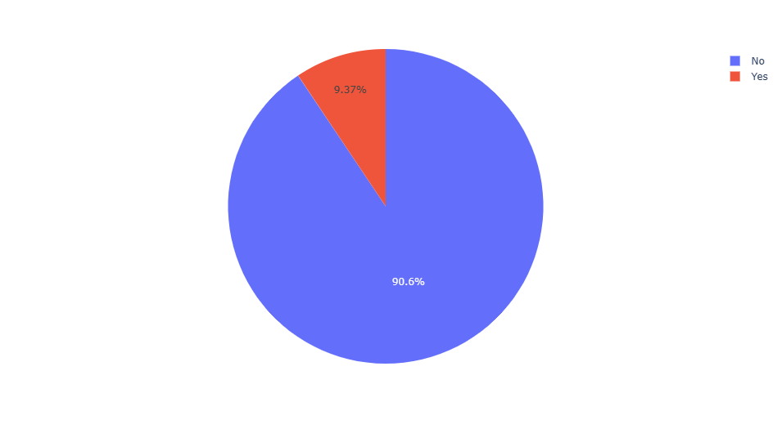
General details about our dataset
percentage of heart disease (target) patients in our dataset:
We can notice that most people in our data set do not have heart disease (Approximately 9 in 100 people suffer from heart disease)

Slide 6
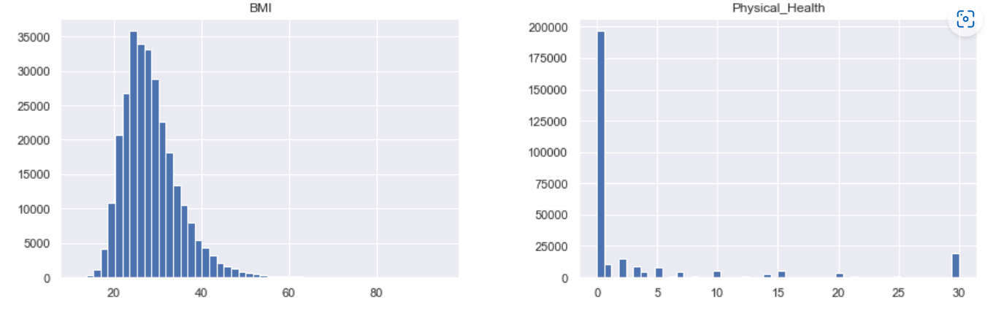
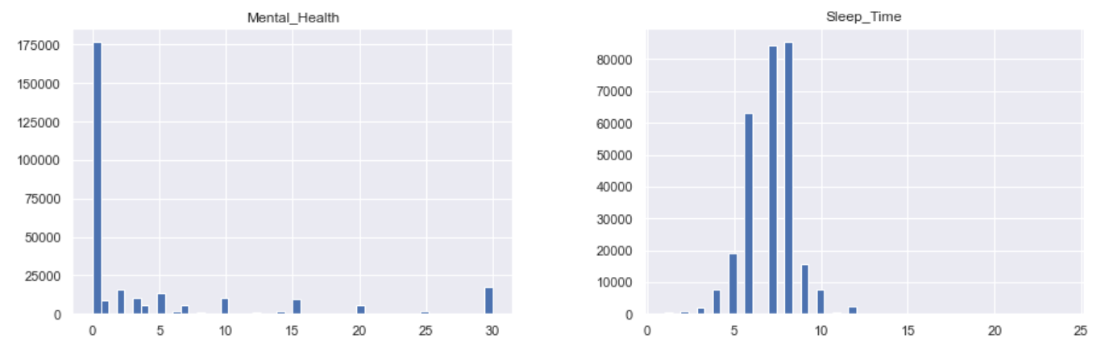
General details about our dataset
distributions of other features:
→ Distribution of numeric value:
'BMI', 'Physical Health', 'Mental Health', 'Sleep Time'

Slide 7
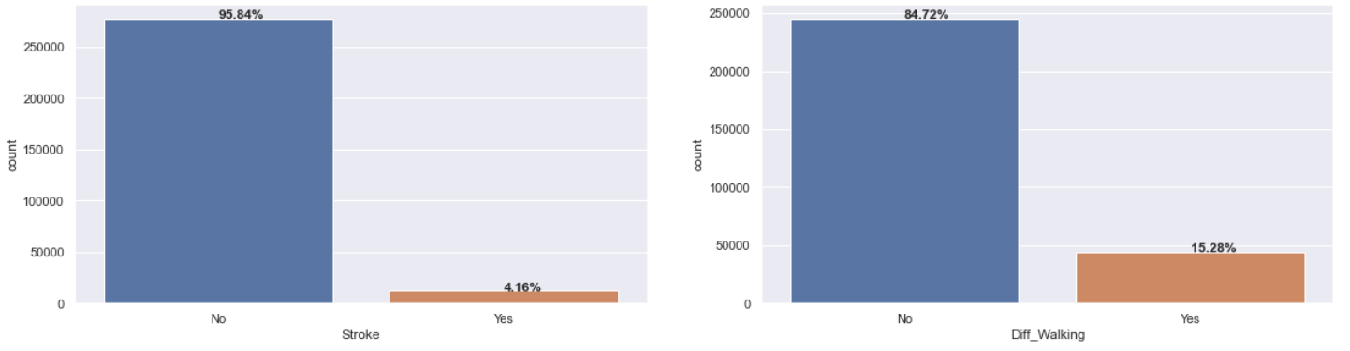
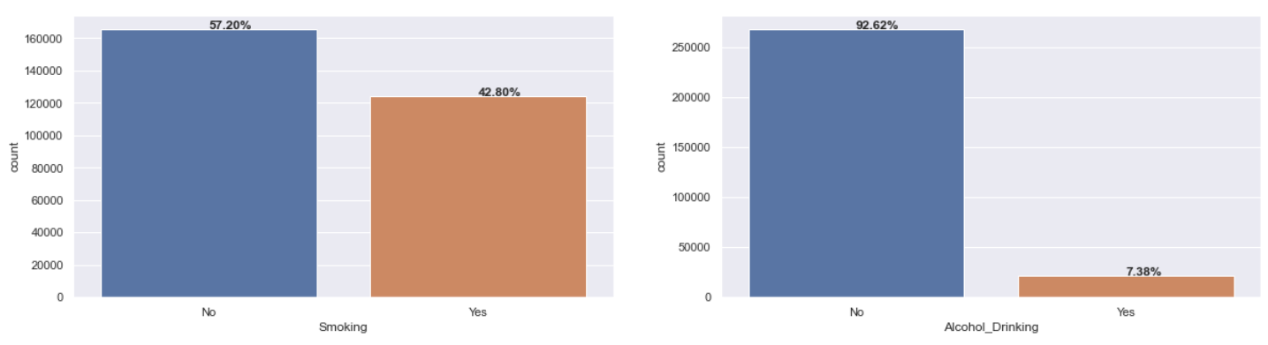
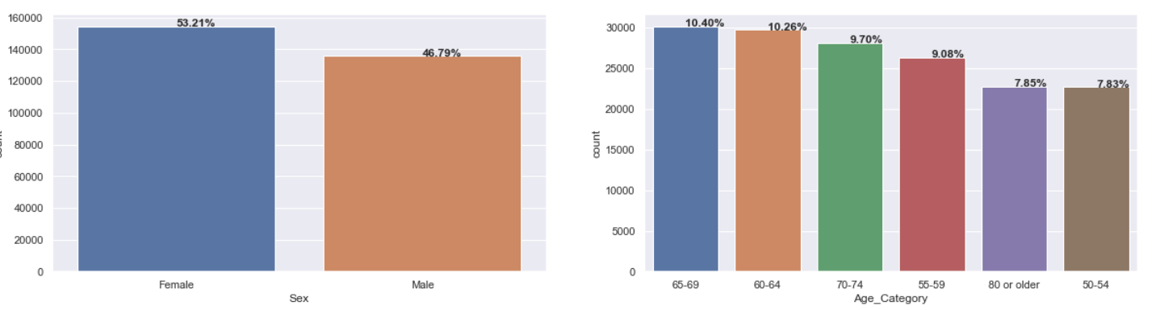
General details about our dataset
Categorical features:

Slide 8
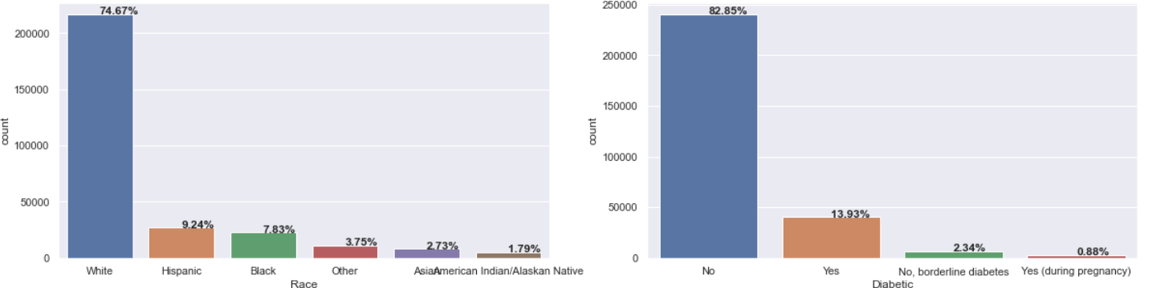
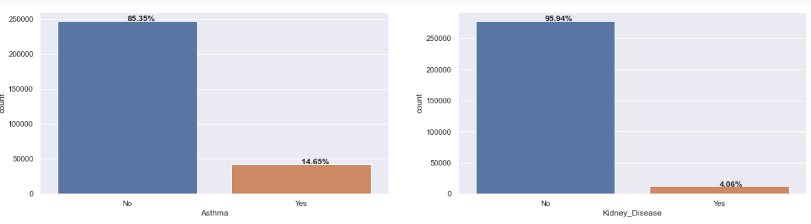

Slide 9
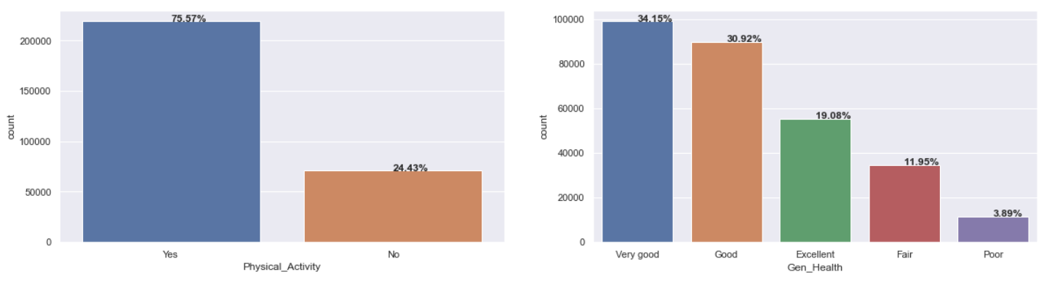
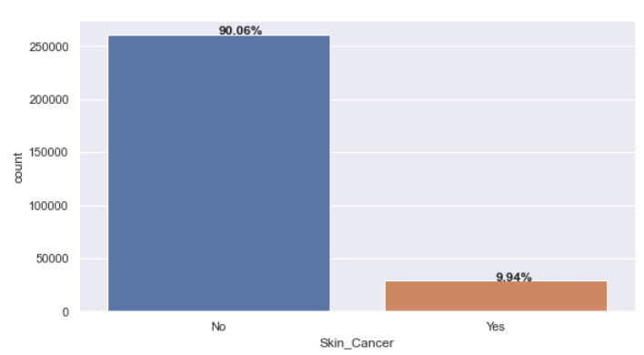
Insights from previous plots:
Most people in our data are white.
Most people are not Alcohol Drinking.
Most of them don't suffer from difficult walk, had a stroke, diabetic, skin cancer, kidney disease, or asthma.
Most of them had done a physical activity during the past 30 days other than their regular job.
A few of people who said that they have generally a poor health.
The percentage of smokers in the dataset is high.
The percentage of males is slightly lower than that of women.

Slide 10
Drawbacks in our data
There are 18078 duplicate rows, so we got rid of them.
We modified the names of the columns to be more clear.
We find outliers in the dataset so, we reduce the percentage of them using z-score.
for more understanding to the BMI we will sort its values in 4 categories (underweight, Normal weight, overweight, Obese, Extremely Obese ) and then we get rid of BMI column.
add new column for average of ages and get rid of age category column.
we notice that the data roughly unbalanced, so we'll handle that with scaling the values

Slide 11
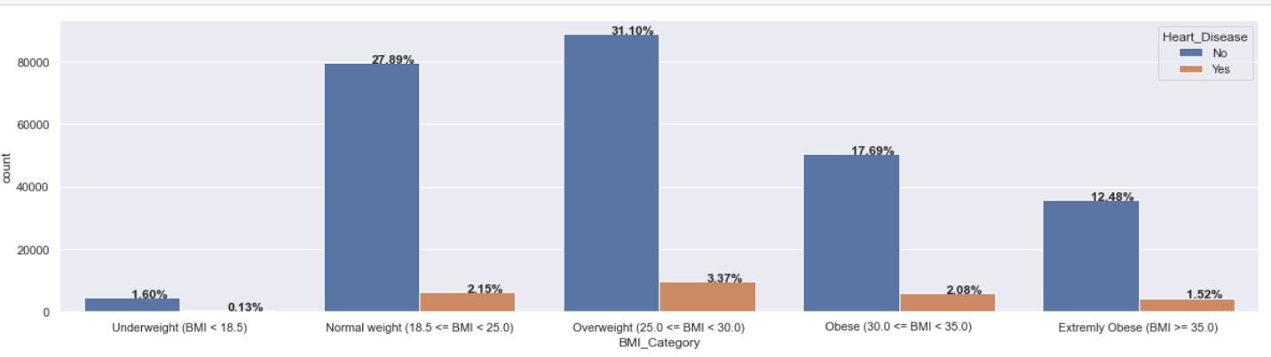
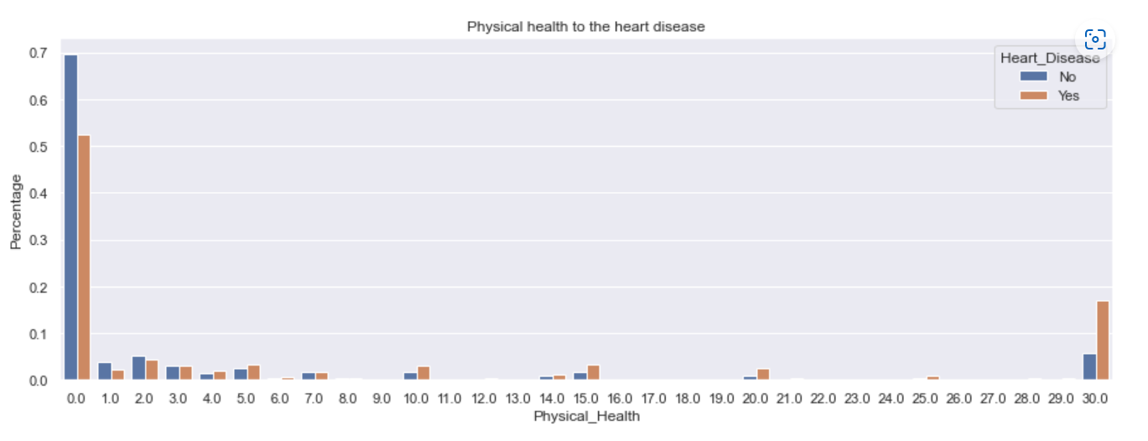
Factor has the most impact on a person's health and chance of getting a Heart Disease:
1-BMI: from this chart we notice that managing the weight of the body maybe affect on having heart disease or not.
2-Physical health: we notice that not managing Physical health can increase the risk of having the heart disease

Slide 12
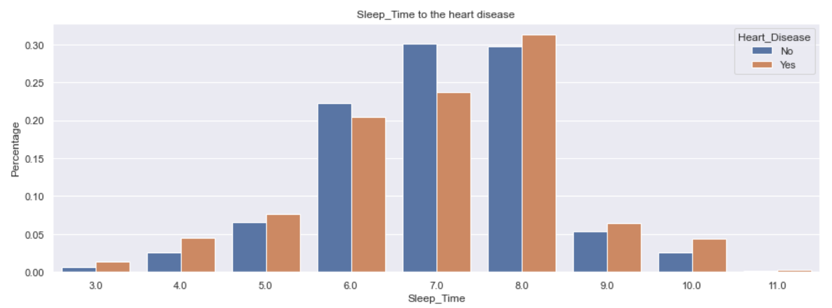
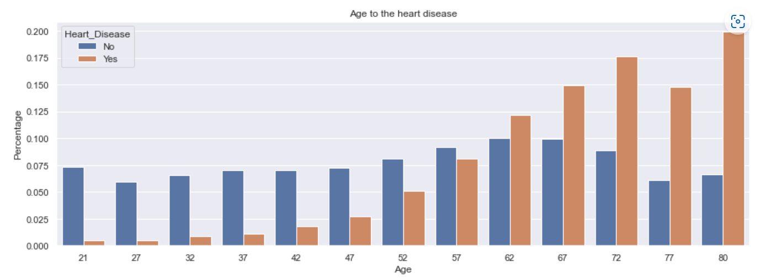
3-Sleeping time: we notice that heart Disease have higher percentages in people that sleep less than 6 hours or more than 8 hours.
4-Age: When people get older the risk of heart disease increase

Slide 13
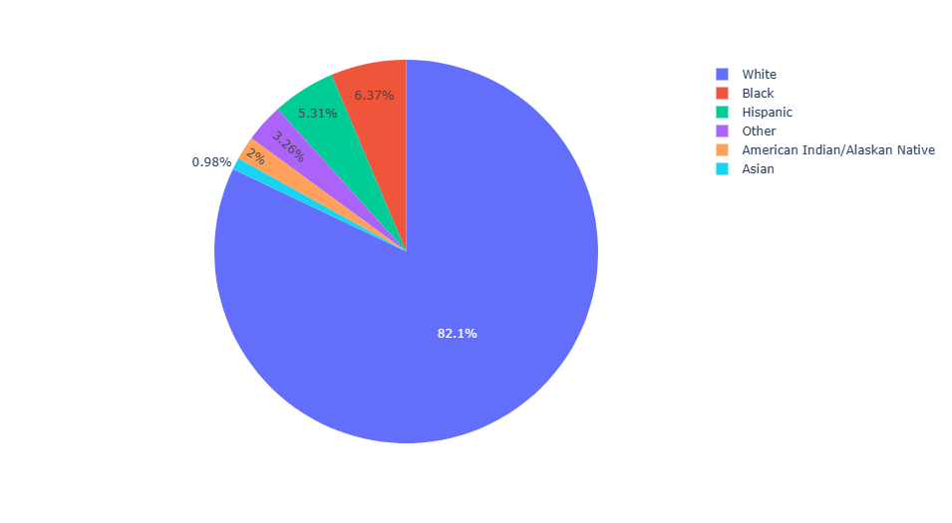
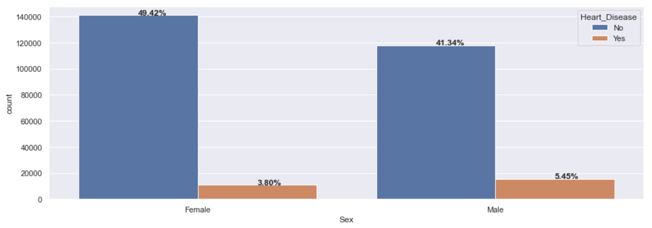
5-Race: it is one of the uncontrolled features that may increase the risk of having heart disease.
We notice that the white race is more susceptible (sensitive) to heart disease than other races
6-Sex: also one of uncontrolled features that can increase the risk of having heart disease.
We notice that male are more prone to heart disease

Slide 14
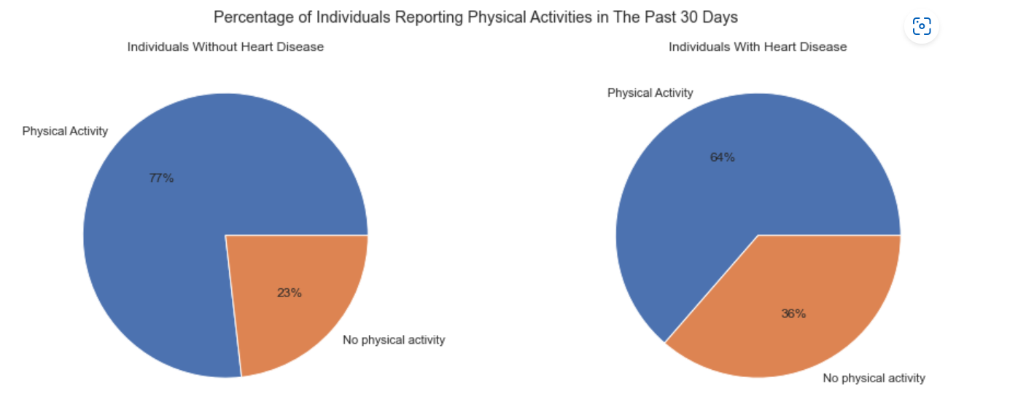
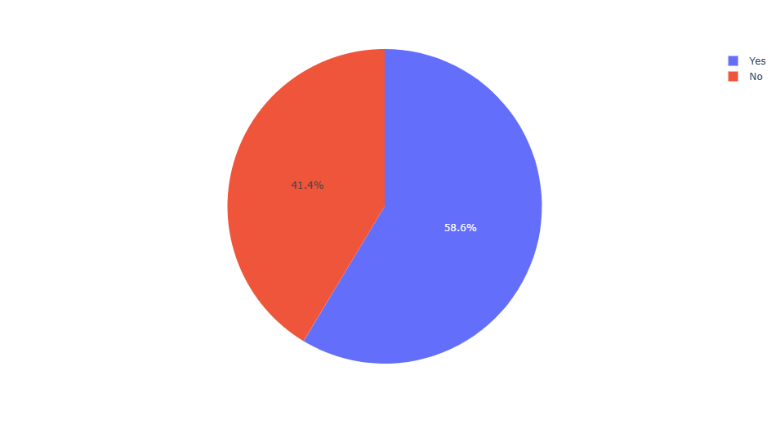
8-Smoking: Smoking can increase the risk of having heart disease
7- physical activity: It is obvious that not managing the physical activity can increase the risk of having heat disease

Slide 15
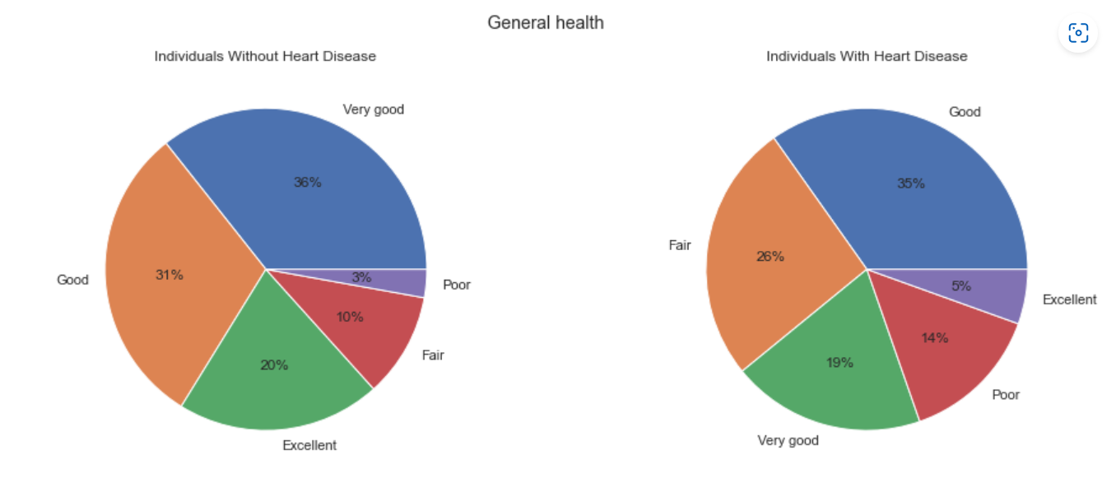
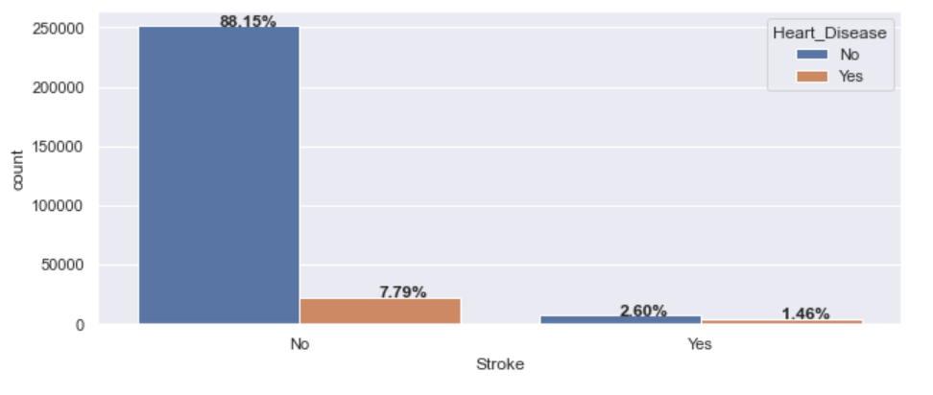
9- General health: People without heart disease are generally in good health. we notice that total percentage of general health in individuals without heart disease (Very good+good+Excellent) = 87%
10- Other diseases: -
Stroke contributes to heart disease.
People with difficulty walking tend to have a higher chance of getting heart disease.
Asthma, kidney disease, skin cancer and diabetes contribute to heart disease. However, asthma only gives a small contribution.

Slide 16
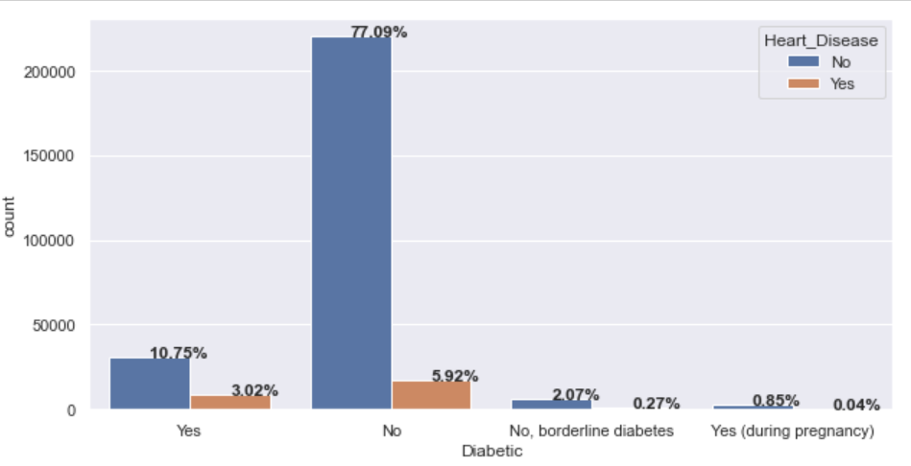
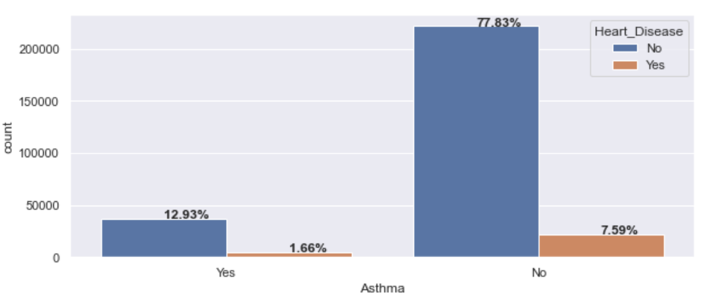
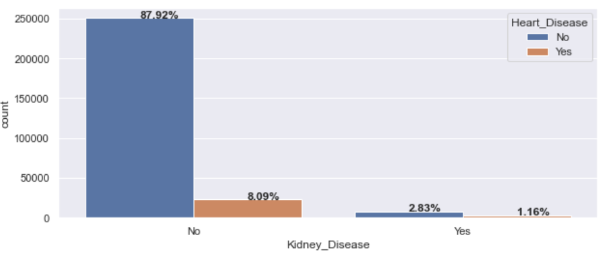
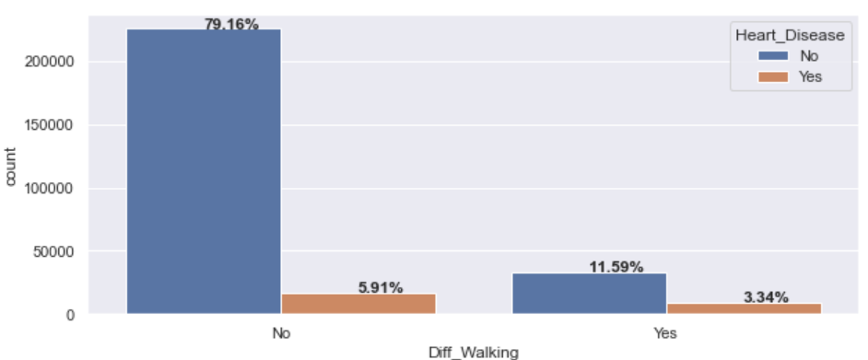
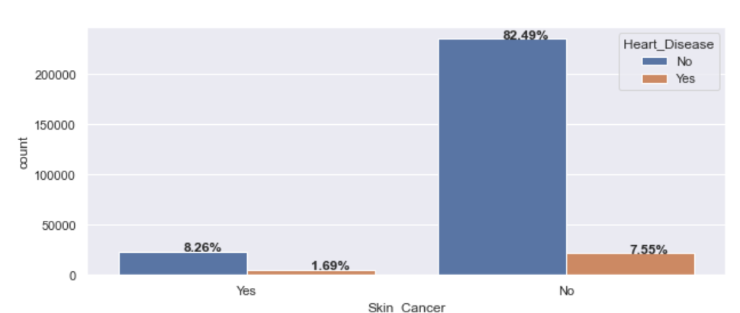

Slide 17
Recommendations:
we notice from charts above that the causes of getting a heart disease increase due to 2 categories of features:
1- uncontrolled features: age, race and gender.
2-controlled features (habits or activities):-
→Smoking: It is preferable to refrain from smoking so that the individual is not more at risk of heart disease.
→Physical activities: Doing physical activities improves general health and reduces the risk of heart disease.
→Sleeping: having the right amount of sleeping reduce the risk of having heart disease.
→BMI: it is highly recommended to manage the weight to be in the normal range.
→General health: managing the general health protect us from heart disease and other diseases.

Slide 18
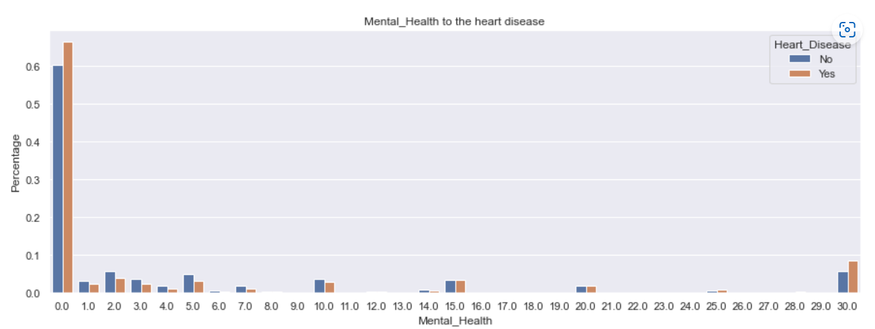
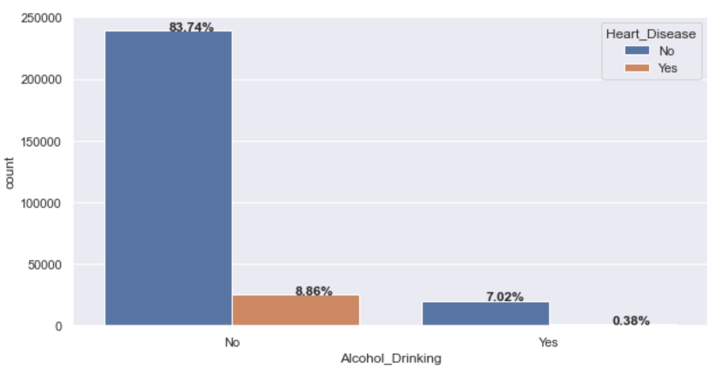
Not all factors affect badly on a person with a Heart Disease
1- Mental health: We notice that mental health does not have that big effect on the risk of having heart disease
2- Drinking alcohol: We notice that drinking alcohol not a factor of heart disease.

Slide 19
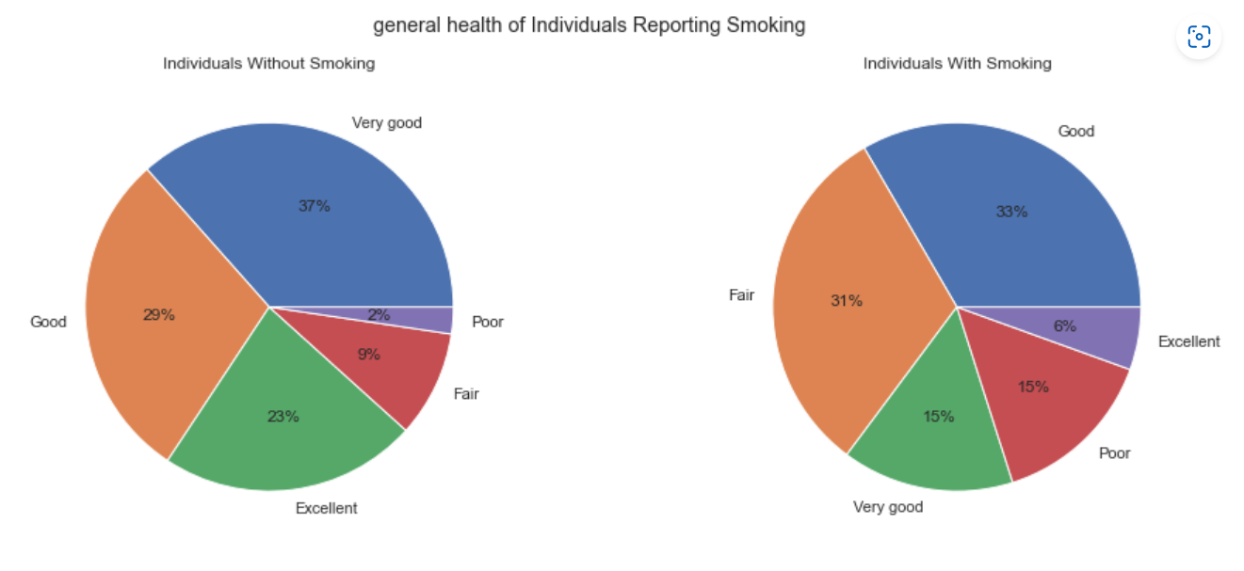
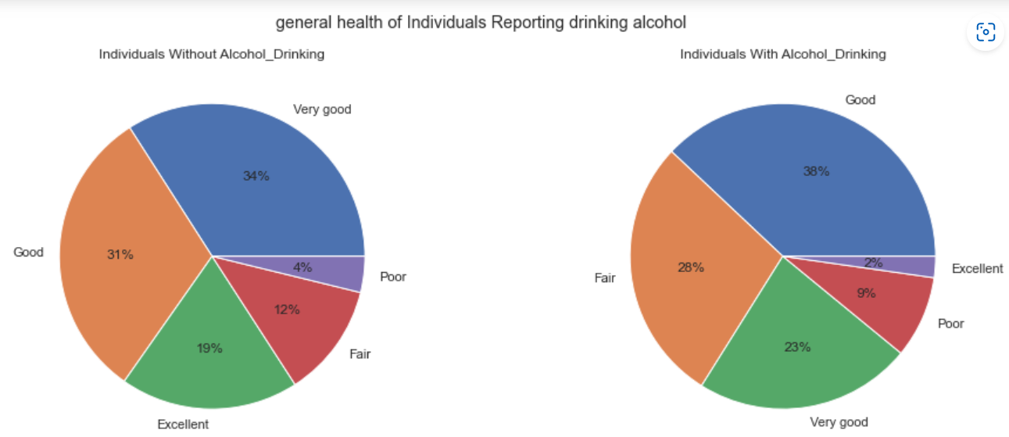
Relation between general health and habits like Smoking, Alcohol Drinking and Physical Activity:
people who are smoking said that they have good health which is odd(people who said that their health Good+Excellent+very good= 57%)
high percentage (63%) of people who drink feel that their general health is good, very good or Excellent

Slide 20
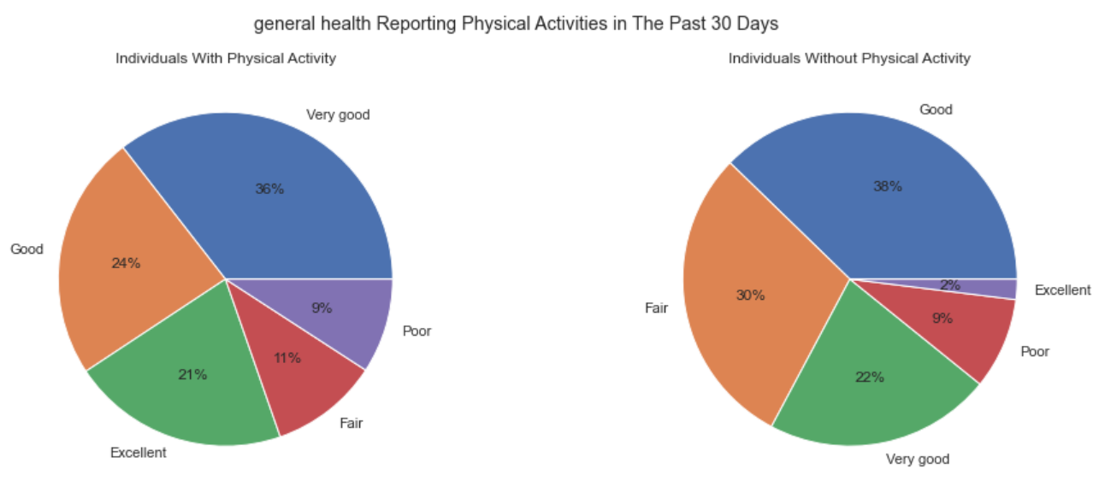
From our database, 62% of people who do not do physical activities feel that their general health is good, very good or excellent
so we notice that these three habits does not have that great impact on general health at short term.

